Slide 1
A Formal language for Critical Human-Machine Interfaces Specification and Validation
Vincent LECRUBIER
PhD Student 2nd year
ONERA, DTIM
Tutors: Bruno d’Ausbourg, Yamine Aït-Ameur

Slide 2
Overview
Context
Need
Objectives
Approach
Results
Perspectives

Slide 3

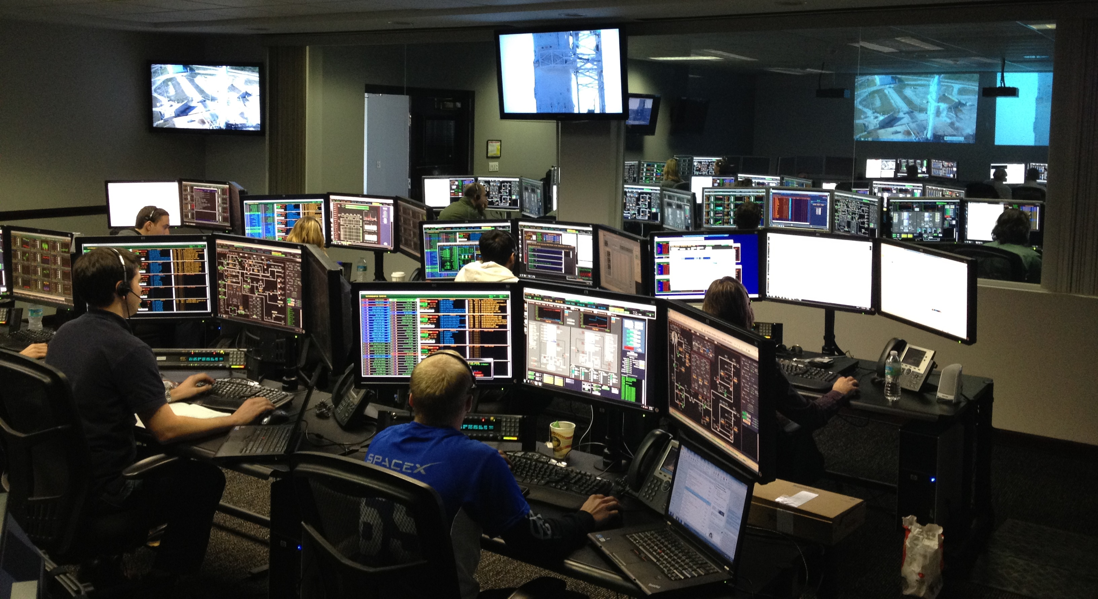
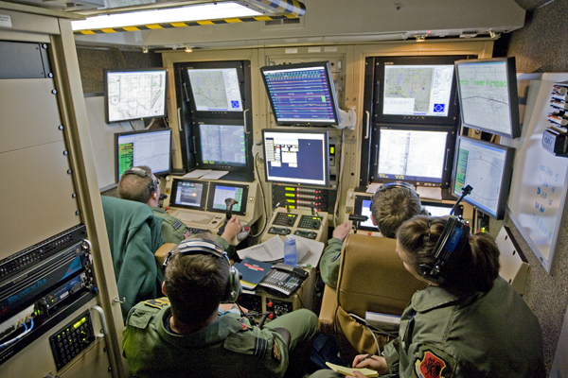
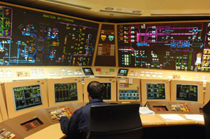


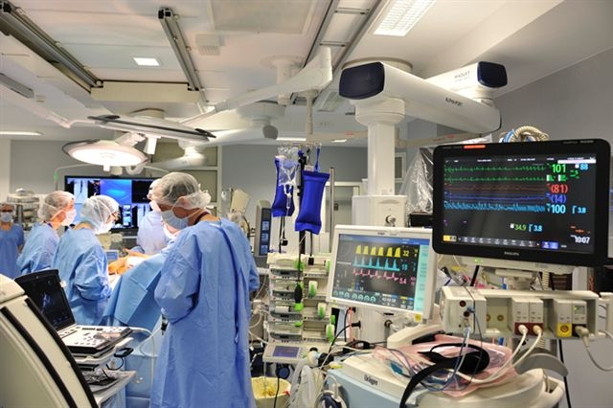
Context: Critical Human Machine Interfaces

Slide 4
Context: Two clashing domains
Formal Proof
Extensive Testing
Static Analysis
Usability Analysis
Formal Methods
Critical HMIs
User Feedback
Petri Nets
Design
State Machines
Human Factors
Model Checking
Prototyping
Critical Systems
Human-machine Interfaces

Slide 5
Context: Focus on cockpit HMIs
ARINC 661
Thesis
Widget Events
Man
Actions
Cockpit
Display System
User Application
Calls
Machine
Perception
Parameter Changes
CallBacks

Slide 6
Problem: A long and costly process
HMI Concept
Textual Specification
HMIs Prototypes
Implemented HMI
Validated HMI
Long
Spécification
Costly
Prototyping
Iterations
Non reactive
Implementation
Non-validation
Complex
Validation

Slide 7
Objective: Enhance the process
HMI Concept
Formal Specification
Validated HMI
Efficient
Spécification
Traceability
Iteration
Reactive
Rewriting
Modular

Slide 8
Approach: Outlines
System Engineer
Human Factor Specialist
Coder
Validation Authority
L Specification
Prototype structure
Human factors properties checks
Code skeleton
Safety properties checks

Slide 9
Approach: Chronology
State of the art
Technology watch
Language definition
Language formalisation
Test case
Application case
Tooling
Year1
Year2
Year3
Year4

Slide 10
Result: The language
Interactor WXRScreen:
State Variables:
String mode_selection in {"OFF","STDBY","TST","WXON","WXA"}
String tilt_selection in {"AUTO","MANUAL"}
String tilt_stabilization in {"ON","OFF"}
Real tilt_angle in [-15 , 15]
Events:
modeChanged(String newModeSelection)
tiltAngleChanged(Real newTiltAngle)
Components:
TextOutput modeSelectionLabel
TextInput modeSelectionInput
TextOutput tiltSelectionLabel
TriggerInputtiltSelectionButton
TextOutput tiltSelectionValueLabel
TextOutput stabilizationLabel
TriggerInput stabilizationButton
TextOutput stabilizationValueLabel
TextOutput tiltAngleLabel
RealInput tiltAngleInput
Bindings:
modeSelectionLabel.text = "Mode selection:"
modeSelectionInput.text = mode_selection
stabilizationValueLabel.text = tilt_stabilization
stabilizationButton.visible = (tilt_selection != "AUTO")
tiltAngleLabel.value = tilt_angle
Behaviors:
Mode Change
Trigger: modeSelectionInput.inputChanged(newInput)
Guard: none
Effect: mode_selection = newInput; modeChanged(mode_selection)
Tilt angle input by user in manual mode
Trigger: tiltAngleInput.inputChanged(newInput)
Guard: tilt_selection == "MANUAL” && tilt_stabilization == "OFF"
Effect: tilt_angle = newInput; tiltAngleChanged(tilt_angle)

Slide 11
Results: The language
Interactor
v1, v2, v3, v4 … vn
Sub-interactor
Sub-interactor

Slide 12
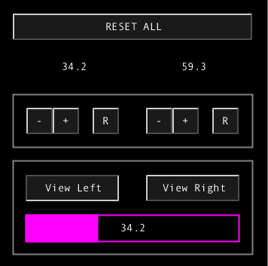
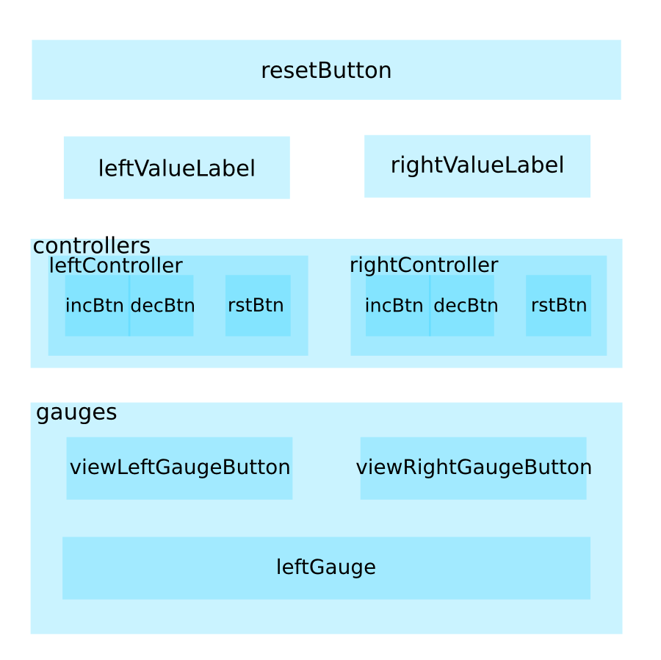
Results: A test case

Slide 13
Perspectives: Properties to check
Performance
Communication
Temporal properties
Usability
Functionality

Slide 14
Perspectives
Enhance the language
Extend the language
Tooling
Certification

Slide 15
Scientific production
Formal H 2012 Workshop, London, UK
http://www.fmhfe.com/FormalH/FormalH.2012.Proceedings.pdf
Appel à projets ANR Blanc 2013
Projet DOLCIA
IHM 2013 Conference, Bordeaux, FR

